Slide 1
Predicting Housing Prices in the Bay Area
By Patrick Anderson, Amanda Delfino, and Mario Morales

Slide 2

Table of Contents
Current State of ML in Real Estate
Problem Statement
Business Case
Approach to Looking at our Data
Data Cleansing
Linear Regression
Random Forest
Conclusions

Slide 3

Current Issues Concerning Machine Learning in Real Estate
Too many systems, collect data in different ways
Timely and complete data is the biggest barrier to entry
Notes:
Amanda

Slide 4
Problem Statement
Can we accurately predict housing prices in the Bay Area using Machine Learning?
Is there a day of the week that is best to list your property?
San Francisco MLS Data
Notes:
Amanda

Slide 5
Business Case
BUYER
Allows buyers to gain confidence around the list price of their property
SELLER
Enable sellers to feel comfortable with pricing estimates regarding their investment
REAL ESTATE ENVIRONMENT
INVESTORS
what goes in to pricing a real investment
Helps appraisers appraise true value of properties for taxes
Notes:
Patrick
Allows buyers to gain confidence around the list price of their property

Slide 6

Data Source and Suggested Approach
Collected data from SF MLS
Predict prices of residential properties in SF, sold in the year 2020.
Use this finding to predict prices on currently active homes in San Francisco.
Notes:
Patrick

Slide 7
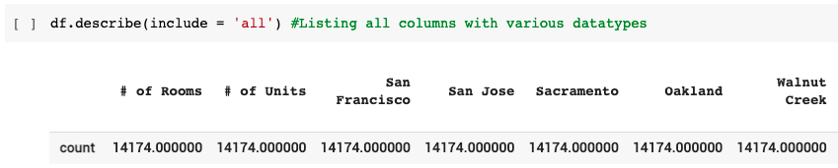
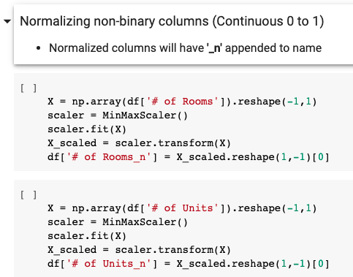
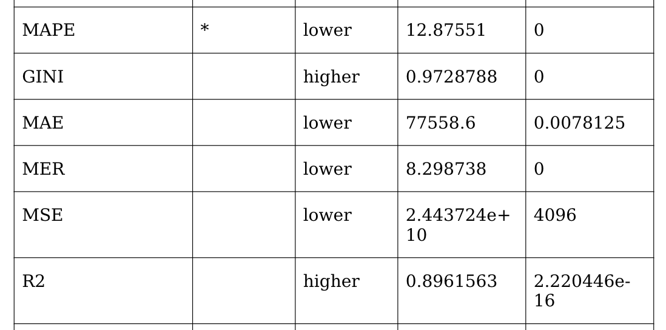
Model - Data Cleansing
Notes:
Amanda
Extract data from the Multiple Listing Service in San Francisco (312 columns, 14K+ rows)
Remove abstract and unusable values from general glance
Evaluate remaining data points, determine if we believe they will help us gain more information around list price
Normalize remaining data points (36 columns, 14K+ rows) , create binary variables
Normalize remaining data points (X how ever many we have left) , create binary variables
Run H2o.AI to determine whether our dataset will aid us in predicting our problem statement
Make final adjustments to dataset in Python file

Slide 8
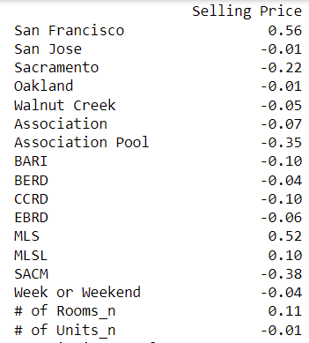
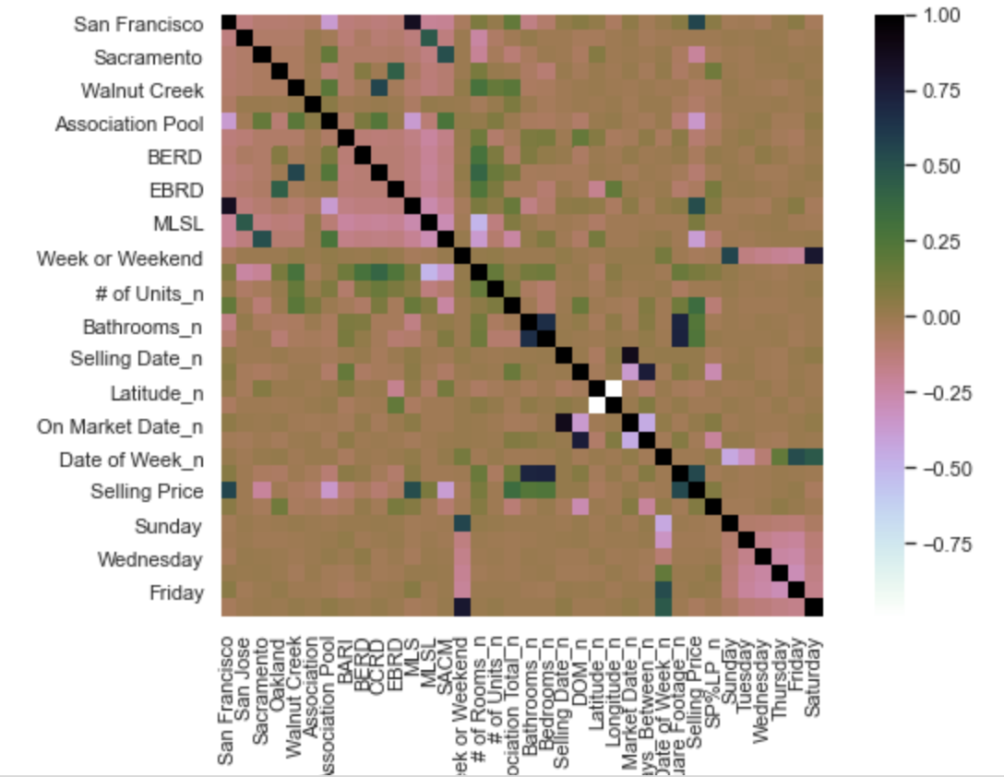
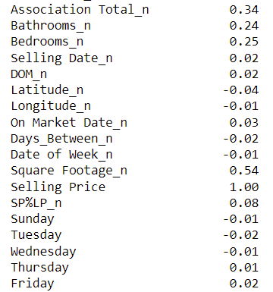

Correlation Heat Map
Notes:
Mario

Slide 9
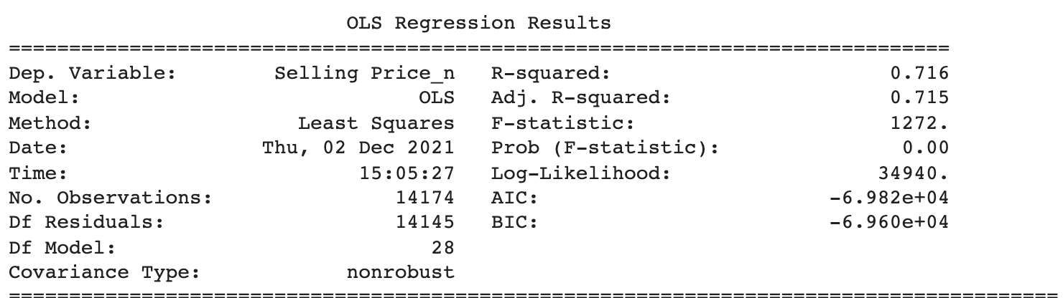
Model - Using Linear Regression
Key Takeaways:
R2 = 0.716
Adj. R2 = 0.715
LR fits 72% of data
Notes:
Mario

Slide 10
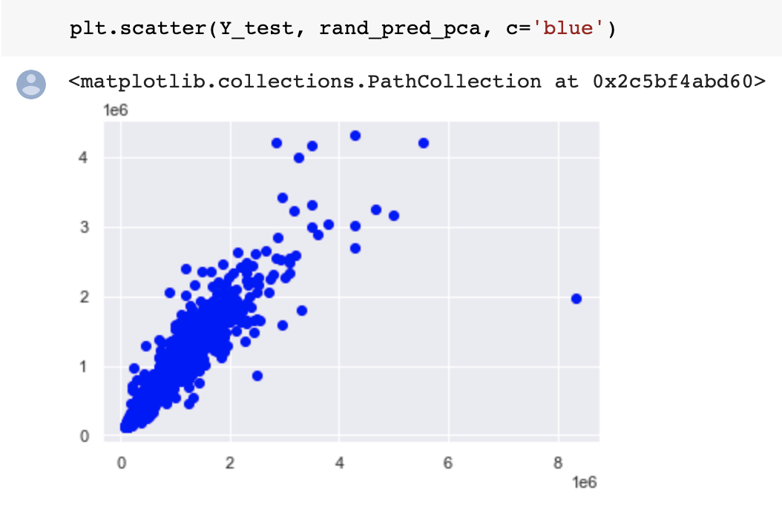
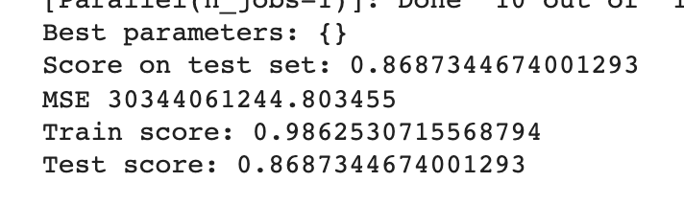
Model - Random Forest on Days of the Week
Key Takeaways:
Train Score: 0.986
Test Score: 0.869
Prediction Accuracy 86%
Higher Variance with prediction of higher Selling Prices
Notes:
Mario

Slide 11
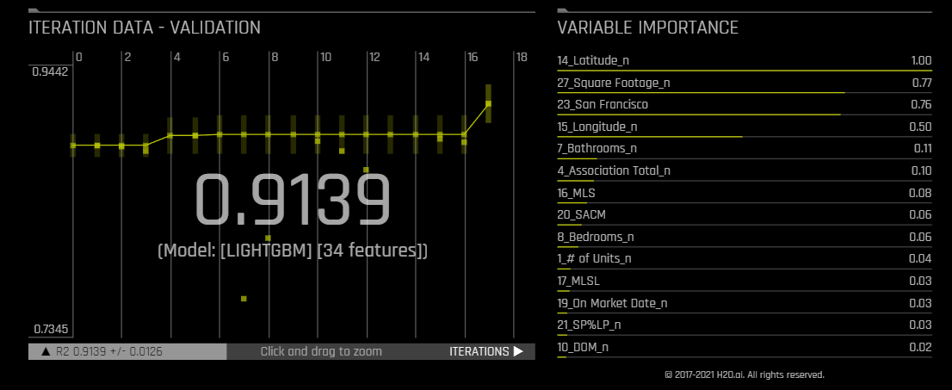
H20.AI Results
Notes:
Patrick

Slide 12
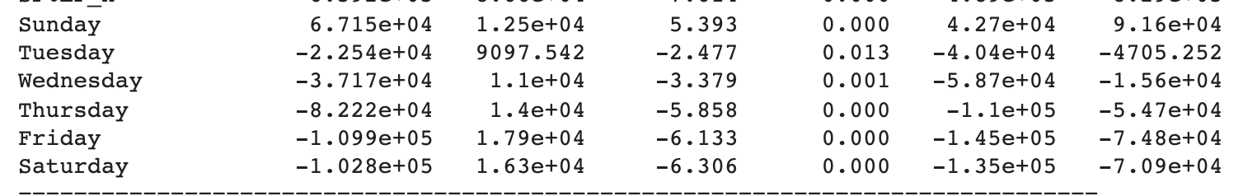
Your Takeaway
The price of a listing is heavily dependent on the location and square footage of the property.
The day of the week a property is listed has a small, but noticeable, effect on the sale price, with Sunday being the best day of the week to list a property.
Notes:
Patrick

Slide 13
Our GitHub Links
Project’s:
https://github.com/panderson-scu/FNCE-2431-Final-Project
Patrick’s:
https://github.com/panderson-scu
Amanda’s:
https://github.com/adelfino22/RealEstateProjections
Mario’s:
https://github.com/mcmorales415/FNCE-2431-Final-Project

Slide 14
Thank You!
If you have further ideas, reach out at: panderson@scu.edu, adelfino@scu.edu, and mcmorales@scu.edu.

